Slide 1
Random Numbers
many uses of random numbers in cryptography
  nonces in authentication protocols to prevent replay
  session keys
  public key generation
  keystream for a one-time pad
in all cases its critical that these values be
  statistically random, uniform distribution, independent
  unpredictability of future values from previous values
Notes:
Random numbers play an important role in the use of encryption for various network security applications. Getting good random numbers is important, but difficult. You don't want someone guessing the key you're using to protect your communications because your "random numbers" weren't (as happened in an early release of Netscape SSL). Need such random values to be both statistically random (with uniform distribution & independent) and also to be unpredictable (so that it is not possible to predict future values having observed previous values).

Slide 2
Types of Random Numbers
PRNG
Using Ciphers as PRNGs
Pseudorandom Function (PRF)
Natural Random Noise (TRNG)

Slide 3
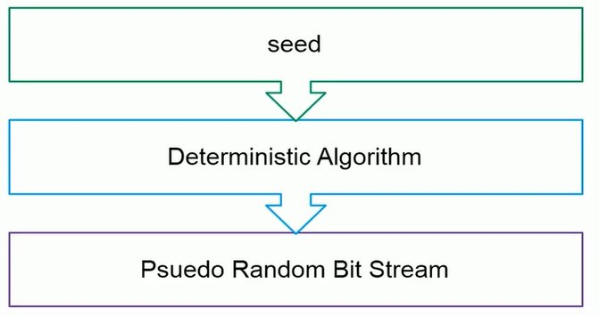
Pseudorandom Number Generators (PRNGs)
often use deterministic algorithmic techniques to create “random numbers”
  although are not truly random
  can pass many tests of “randomness”
generates a long-length random number using algorithms based on a short initial value.
known as “pseudorandom numbers”
created by “Pseudorandom Number Generators (PRNGs)”

Slide 4
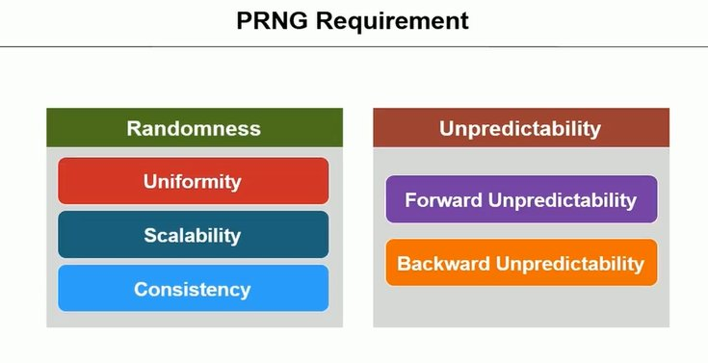

Slide 5
Using Block Ciphers as PRNGs
for cryptographic applications, can use a block cipher to generate random numbers
often for creating session keys from master key
Counter Mode
  X_{i} = E_{Km}[i]
Output Feedback Mode
  X_{i} = E_{Km}[X_{i-1}]
Notes:
For cryptographic applications, it makes some sense to take advantage of any block cipher encryption functions available to produce random numbers. Can use the Counter Mode or Output Feedback Mode, typically for session key generation from a master key.

Slide 6
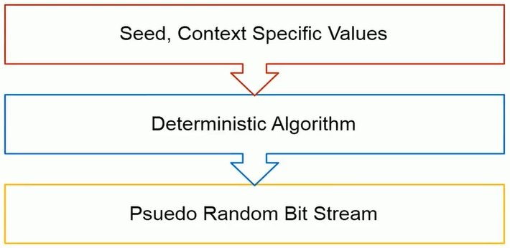
Pseudorandom Function
It is used to produce pseudorandom string of bits of some fixed length.
Examples :
Symmetric encryption keys
nonces.

Slide 7
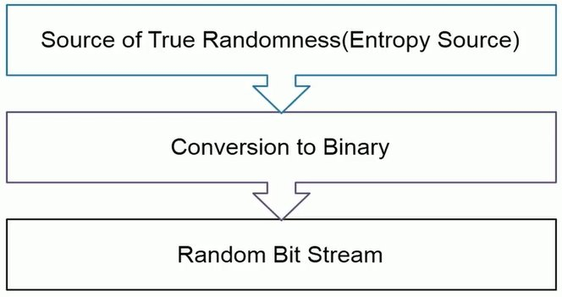
Natural Random Noise (TRNG)
best source is natural randomness in real world
find a regular but random event and monitor
do generally need special h/w to do this
  eg. radiation counters, radio noise, audio noise, thermal noise in diodes, leaky capacitors, mercury discharge tubes etc
starting to see such h/w in new CPU's
problems of bias or uneven distribution in signal
  have to compensate for this when sample and use
  best to only use a few noisiest bits from each sample

Slide 8
PRNG V/S TRNG
PRNG
TRNG
PRNG is Deterministic System.
PRNG intentionally generates a random number, not a complete random number
The number is usually generated by a software way.
TRNG is non-deterministic.
TRNG, on the other hand, generates a true random number.
It is generated primarily by hardware way.

